Slide 1
AGILE AND SCRUM

Slide 2
AGILE
Agile is an iterative and incremental approach to software development methodology.
The agile software development model was proposed in the mid-1990s to overcome the serious shortcomings of the waterfall model of development identified above. The agile model was primarily designed to help a project to adapt to change requests quickly. Thus, a major aim of the agile models is to facilitate quick project completion.

Slide 3
Agile model is being used as an umbrella term to refer to a group of development processes. These processes share certain common characteristics, but do have certain subtle differences among themselves
Atern (formerly DSDM)
Feature-driven development
Scrum
Extreme programming (XP)
Lean development Unified process
Crystal

Slide 4
Agile manifesto
Working software over comprehensive documentation.
Frequent delivery of incremental versions of the software to the customer in intervals of few weeks.
Requirement change requests from the customer are encouraged and are efficiently incorporated.
Face-to-face communication rather than through exchange of formal documents.
Agile development projects usually deploy pair programming.

Slide 5
SCRUM
Entire work is divided into small parts that can incrementally be developed and delivered over time boxes. These time boxes are called sprints.
At the end of each sprint, the stakeholders meet to assess the developed software increment. The stakeholders may suggest any changes and improvements to the developed software that they might feel necessary.

Slide 6
KEY ROLES AND RESPONSIBILITIES
Product owner: Represents customer’s perspective
Scrum master: acts as project manager
Team member: team members with expertise in different areas
Self-organising team

Slide 7
Sprint artifacts
Product backlog(dynamic document -lists all features yet to be developed)
Sprint backlog(lists tasks identified and committed by team to develop and complete during sprint)
Sprint burndown chart(tool to visualize progress made & work remaining to be undertaken on a daily basis)

Slide 8
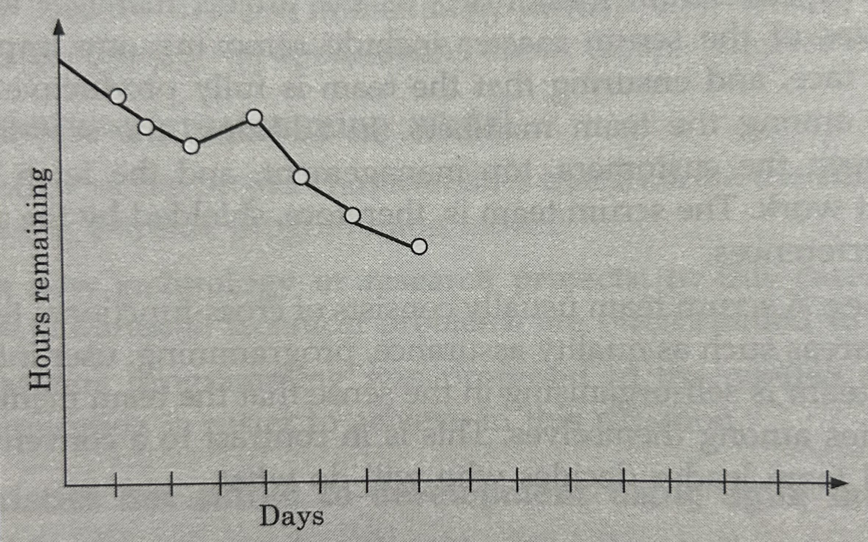
Sprint burndown chart

Slide 9
Scrum Ceremonies
Sprint Planning(Team members commit to develop and deliver certain features , out of those listed in the product backlog)
Daily scrum(short stand up meeting conducted daily to review status of progress achieved and major issues being faced daily)
Sprint review meeting(at the end of each sprint; team demonstrates new functionality developed during the sprint just completed and feedback collected)

Slide 10
KEY DIFFERENCES
Agile is a continuous iteration of development and testing in the software development process whereas Scrum is an Agile process to focus on delivering the business value in the shortest time.
Agile methodology delivers the software on a regular basis for feedback while Scrum delivers the software after each sprint.

Slide 11
In the Agile process, leadership plays a vital role; on the other hand, Scrum fosters a self-organizing, cross-functional team.
Agile involves collaborations and face-to-face interactions between the members of various cross-functional teams whereas Scrum collaboration is achieved in daily stand up meetings.
In Agile process design and execution should be kept simple whereas in Scrum process design and execution can be innovative and experimental.

